Slide 1
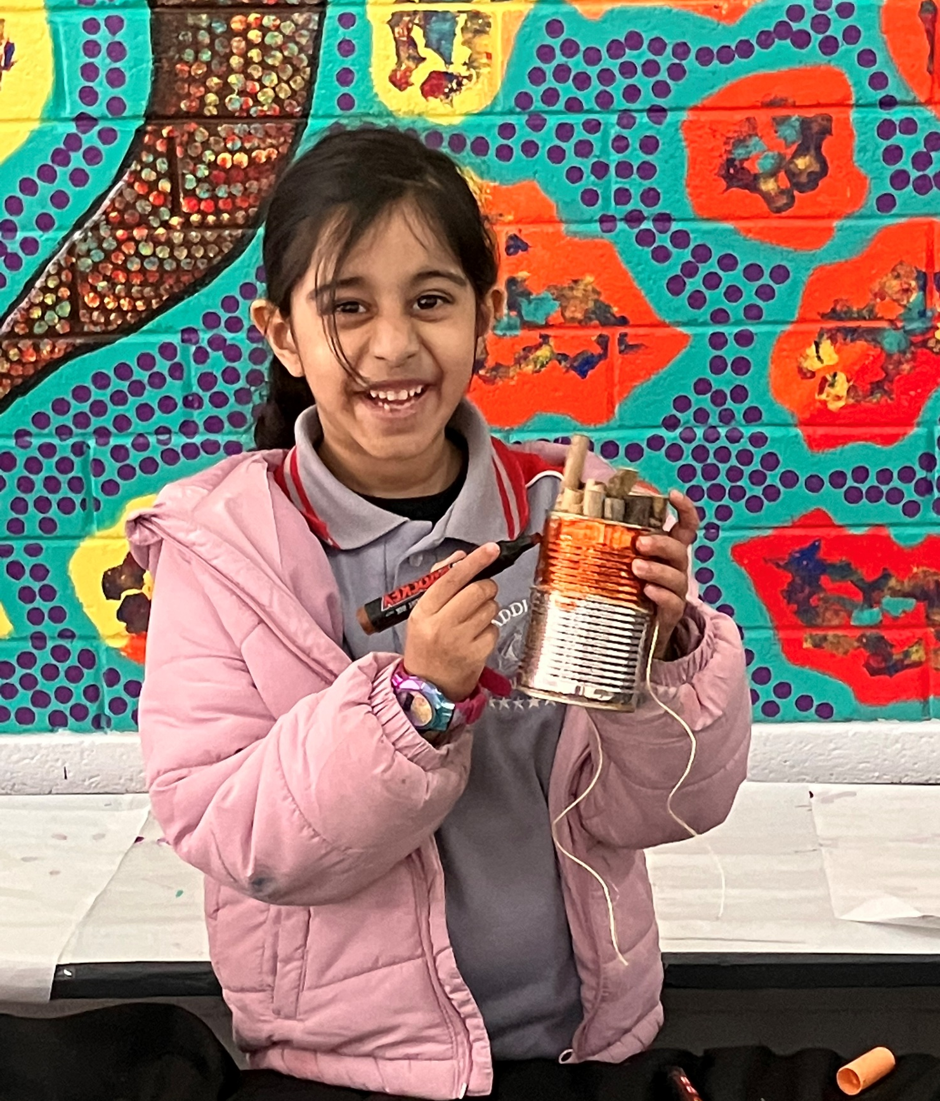

Waddington Primary School
2026 Kindergarten Information
Respect • Responsibility • Kindness • Persistence • Courage

Slide 2
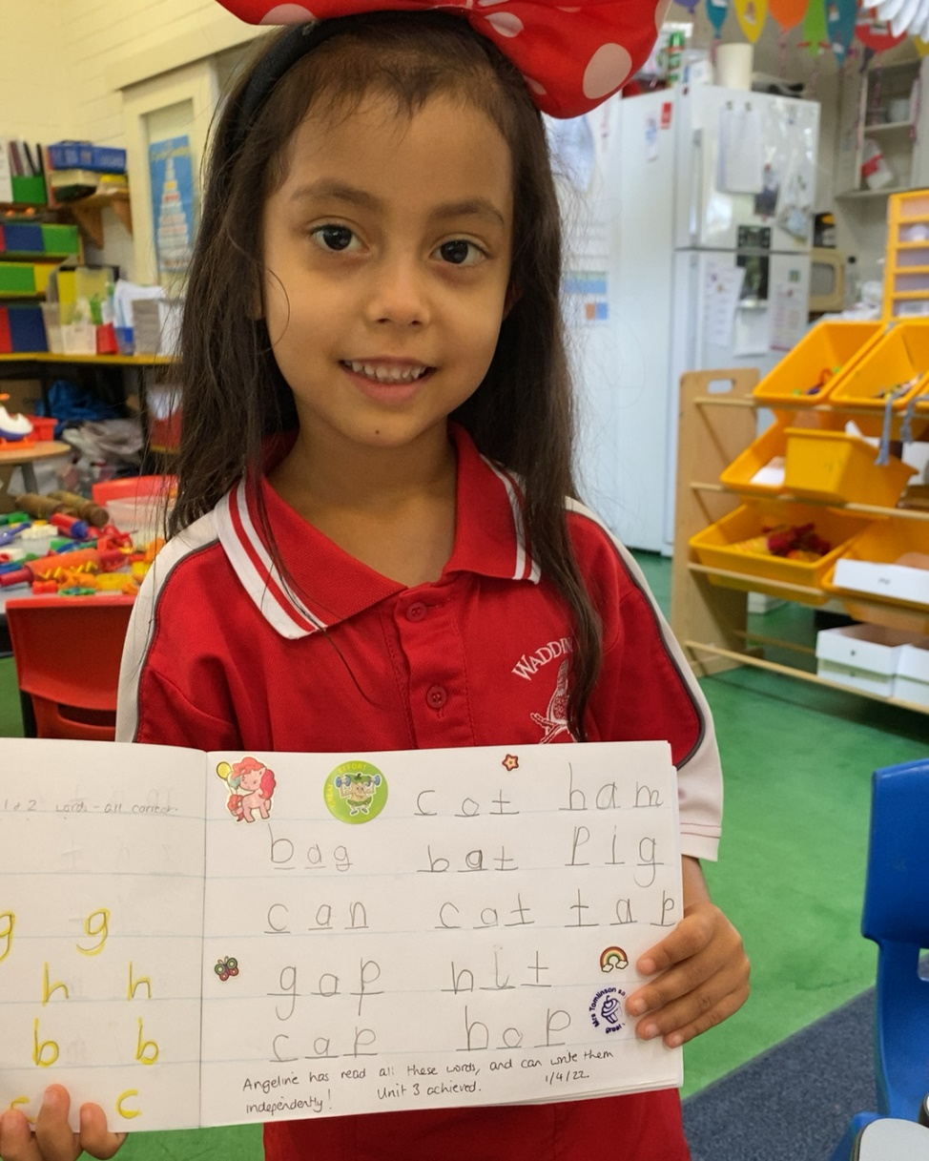
Welcome to Waddington!
Waddington Primary School is an innovative school that provides individual attention to children from Kindergarten to Year Six. We have a strong focus on pastoral care and value the positive relationships we have with our school community. We cater to families seeking individualised care, with a strong community feel.
At Waddington we have high expectations of all our students and encourage everyone to strive to succeed.
Waddington Primary School’s core values are Respect, Responsibility, Kindness, Persistence and Courage. These values are embedded across the school in all that we do and are at the centre of the conversations we have with the children in our care. Our school motto is ‘Strive to Succeed’.
If this is your first child attending school, you are likely to have many questions - please don’t hesitate to ask.
Respect • Responsibility • Kindness • Persistence • Courage

Slide 3
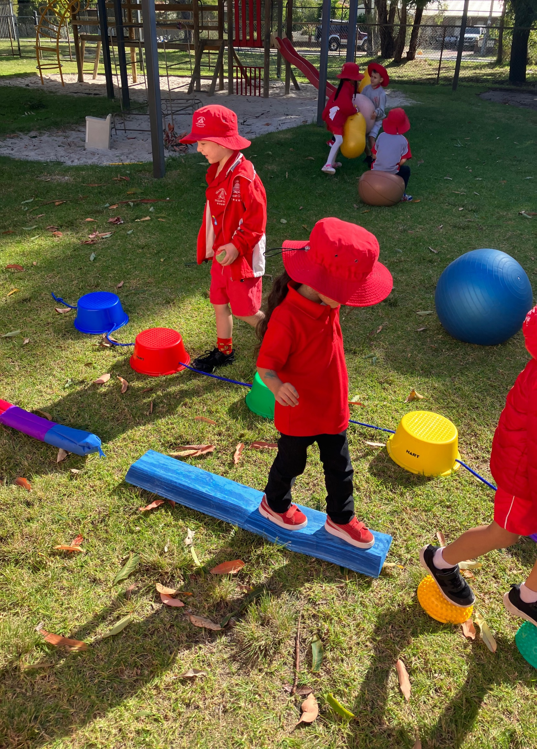
Respect • Responsibility • Kindness • Persistence • Courage

Slide 4
The Early Childhood Program
A balanced early years program will be grounded in intentional teaching. At Waddington, our teachers use Explicit Direct Instruction (EDI) strategies to maximise engagement, create well designed lessons and ensure explicit teaching of the year level content.
Our lead teachers are also instructional coaches, working with our teaching staff and education assistants to build competence and encouraging professional learning around areas through self-reflection. This is a skill we teach our students from the start of school. What did I do well, what could I have done differently, what do I need to get better at… etc. Other whole school programs taught at Waddington from Kindergarten to Year 6 are Sounds Write, Heggerty Phonological, Awareness Talk for Writing, Oral Language Programs and iMaths.
In addition to this, we value play as an integral part of early childhood education. Through play children learn valuable skills that include problem solving, story making, developing their imagination and experimenting with trial and error. Play also helps children gain confidence in co-operating and creating relationships with their classmates. At Waddington children are given many opportunities to learn and express their thoughts, creativity and ideas in a play-based environment.
Our planning and daily activities integrate the Early Years Framework, National Quality Standards (NQS), West Australian Curriculum and the Kindergarten Curriculum Guidelines. This allows us to provide your child with a well-rounded education that encourages independence, self-discipline and a love of learning.
At Waddington Primary School we foster an inclusive environment where all students are valued and respected.
Parents in the classroom
Parents are a vital part of their child’s education. At Waddington we value parent’s involvement and welcome Kindy and Pre-Primary parents into the classroom every morning before the school day commences. The classroom doors open at 8:30am and parents are welcome to settle their child by reading a story or completing a puzzle before leaving at 8.45am.
Respect • Responsibility • Kindness • Persistence • Courage

Slide 5
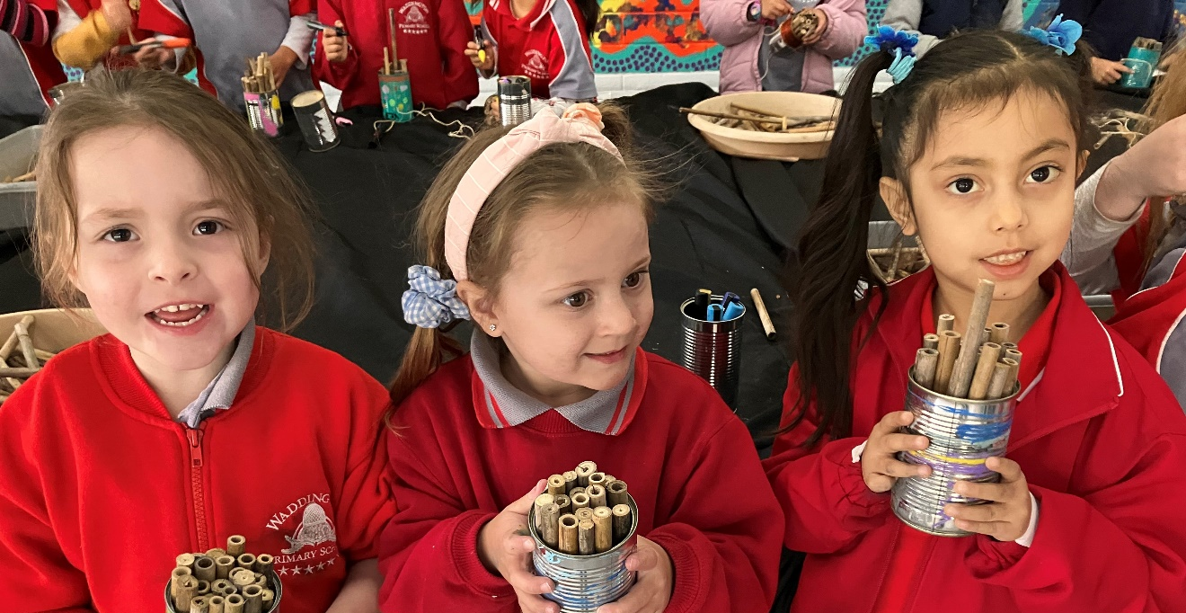
2026 Term Dates
School Hours
Time | Event
8:30am | Classroom opens Parents welcome – for story reading or puzzles
8:45am | Parents leave classroom
10:40am – 11am | Morning Recess
12:40pm – 1:20pm | Lunch
3pm (2:30pm Wednesdays) | End of day
 | Start | Finish
Term 1 (9 weeks) | Monday 2nd February | Thursday 2nd April
Term 2 (11 weeks) | Monday 20th April | Friday 3rd July
Term 3 (10 weeks) | Monday 20th July | Friday 25th September
Term 4 (10 weeks) | Monday 12th October | Thursday 17th December
Respect • Responsibility • Kindness • Persistence • Courage

Slide 6
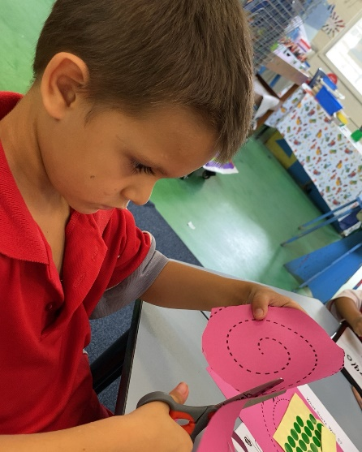
Arriving Late / Leaving Early
The School Day
During the school day we implement a range of activities to develop children to their full potential. These include:
Literacy activities
Mathematics activities
Fundamental Movement Skills
Speech and oral language programs
Engineering and STEM activities
Indoor and outdoor play
Art and craft activities
Protective behaviours
Students are expected to arrive at school and be in their classrooms by 8:45am, in time for the siren. Students who arrive after this time, need to go to the school’s reception to get a late note before going to class.
If you need to take your child out of school during the day, you will need to go to the school’s reception to sign your child out. The staff will arrange for your child to be brought to reception. Any person collecting your child from the school will need to be listed on the enrolment form and/or recorded on our student information system as having authority to collect.
Absentees / Illness
If your child is unwell and unable to attend school, please contact the school by phone or add an attendance note via Compass, so the teacher can be informed. If we have not heard from you by 10am, you will receive a text message requesting the reason for their absence.
Please make sure if your child has had a temperature, cough, diarrhoea or has been vomiting, to keep them home for 24 hours past the last episode.
If you child becomes unwell at school, we will contact the emergency contact, in the order that was provided on the enrolment form.
Respect • Responsibility • Kindness • Persistence • Courage

Slide 7
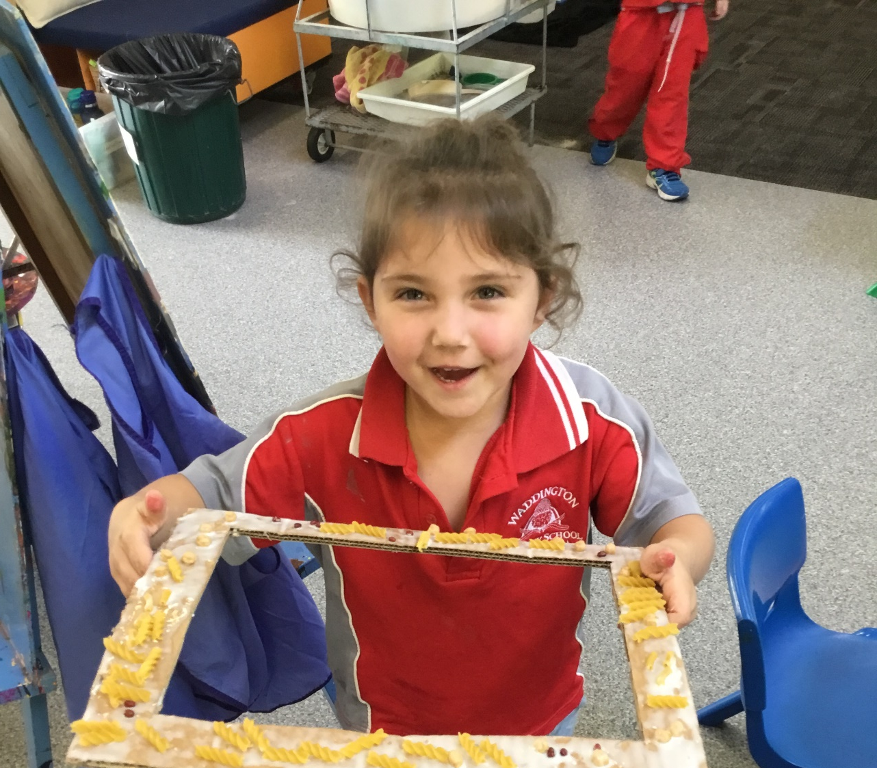
Early Childhood Centre Groups
In 2026, we will have a mix of Kindergarten and Pre-primary children in our Early Childhood Centre. Kindy students will attend Monday, Tuesday and every alternate Wednesday on odd weeks during the term, with the Pre-primary children attending daily throughout the week. This will equate to 5 days of Kindy each fortnight.
Alternating Wednesdays
 | Kindergarten Students attend school on Wednesdays on these weeks
Term 1 (9 weeks) | Weeks 1, 3, 5, 7 & 9
Term 2 (11 weeks) | Weeks 1, 3, 5, 7, 9, 11
Term 3 (10 weeks) | Weeks 1, 3, 5, 7 & 9
Term 4 (10 weeks) | Weeks 1, 3, 5, 7 & 9
Respect • Responsibility • Kindness • Persistence • Courage

Slide 8

Equipment Required
Please ensure your child brings the
following items to school each day:
School Bag
School Hat
Fruit and snacks for recess
Drink Bottle
Lunch box with packed lunch
Spare set of clothing, including shirt, pants, underwear and socks
School Uniforms
Our aim is to have all children in uniforms each day. To that end, we sell our uniforms at cost price. We have a strict ‘No Hat, No Sun’ policy at Waddington. This means that children must remain in a designated undercover area during play times if they are not wearing a bucket hat.
Children will be allocated a faction before their first day (Kawlool - Green or Marloo - Blue).
Uniforms can be purchased from our Uniform Shop situated in Block 3 on Fridays from 2.45pm to 3.15pm or complete an order form that can be found at the front office or downloaded from the school's website. We do not have EFTPOS facilities available so payment needs to be in cash (correct amount as change cannot be given) or direct bank transfer (BSB 016 353 Account 3408 73676) including your child’s name and uniforms in the narration. For example, C.Smith – Uniforms.
Respect • Responsibility • Kindness • Persistence • Courage

Slide 9
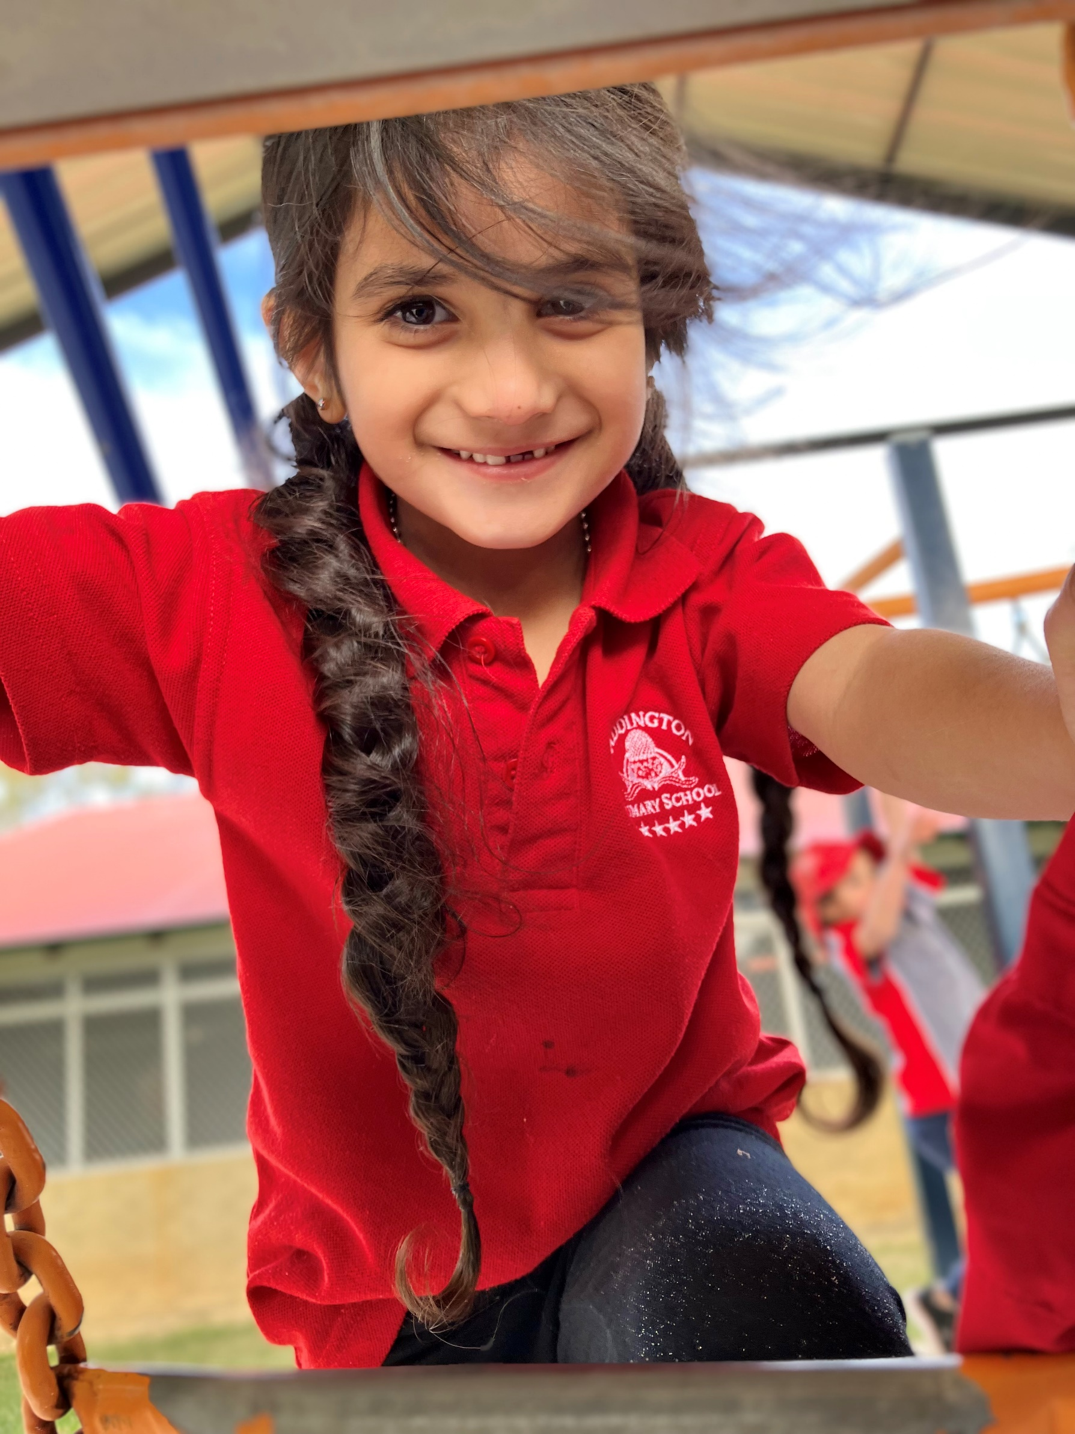
Respect • Responsibility • Kindness • Persistence • Courage

Slide 10
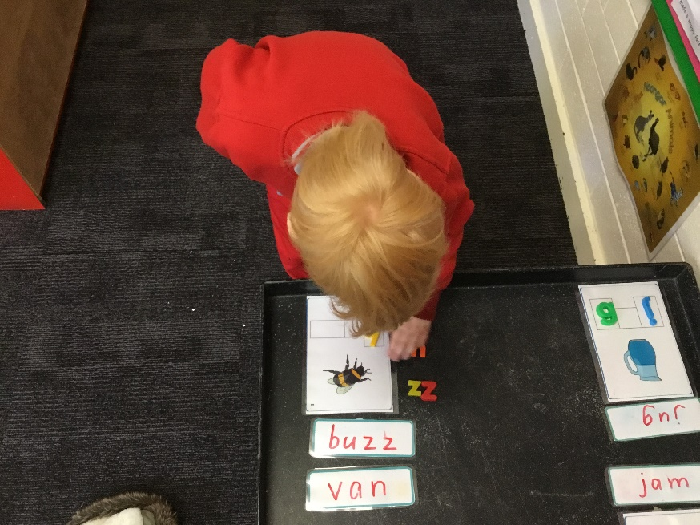
Change of Information
The information you provide on the enrolment form is very important in helping us look after your child and needs to be kept up to date.
In particular, we need to know of any changes to your:
Address
Email
Phone numbers
Emergency contacts
Custody information
Child’s medical information
Voluntary Contributions
Voluntary contributions provide our school with additional funds, which allow us to enhance the educational programs and resources to the children.
The contribution amount is kept to a minimum as we understand that there are financial pressures on many families.
You can make your contribution of $35 per child at Reception.
Respect • Responsibility • Kindness • Persistence • Courage

Slide 11

Respect • Responsibility • Kindness • Persistence • Courage

Slide 12
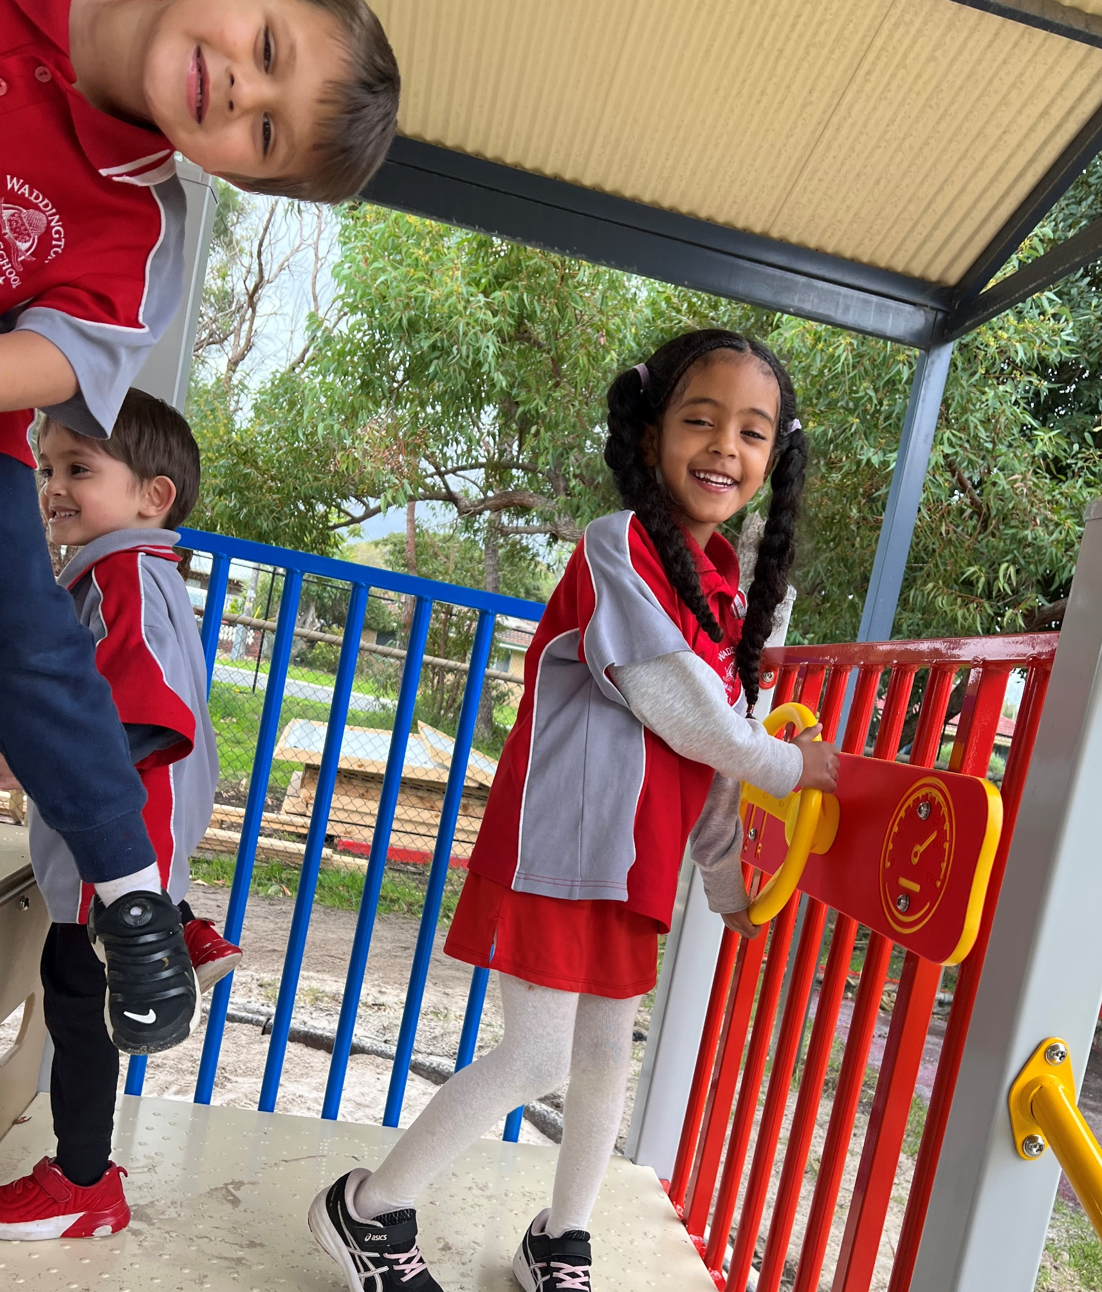
Waddington Primary School
2026 Kindergarten Information
Respect • Responsibility • Kindness • Persistence • Courage

Slide 13


Waddington Primary School
2026 Kindergarten Information
WADDINGTON PRIMARY SCHOOL CONTACT DETAILS
Address: 15 Henniker Way, Koondoola WA 6064
Office hours: 8:30am to 3:30pm
Email: Waddington.ps@education.wa.edu.au
Office Phone: (08) 9462 9500
School website: www.waddingtonps.wa.edu.au
Follow us on social media
Facebook: Waddington Primary School
Instagram: waddington_primary_school
Respect • Responsibility • Kindness • Persistence • Courage

