Slide 1
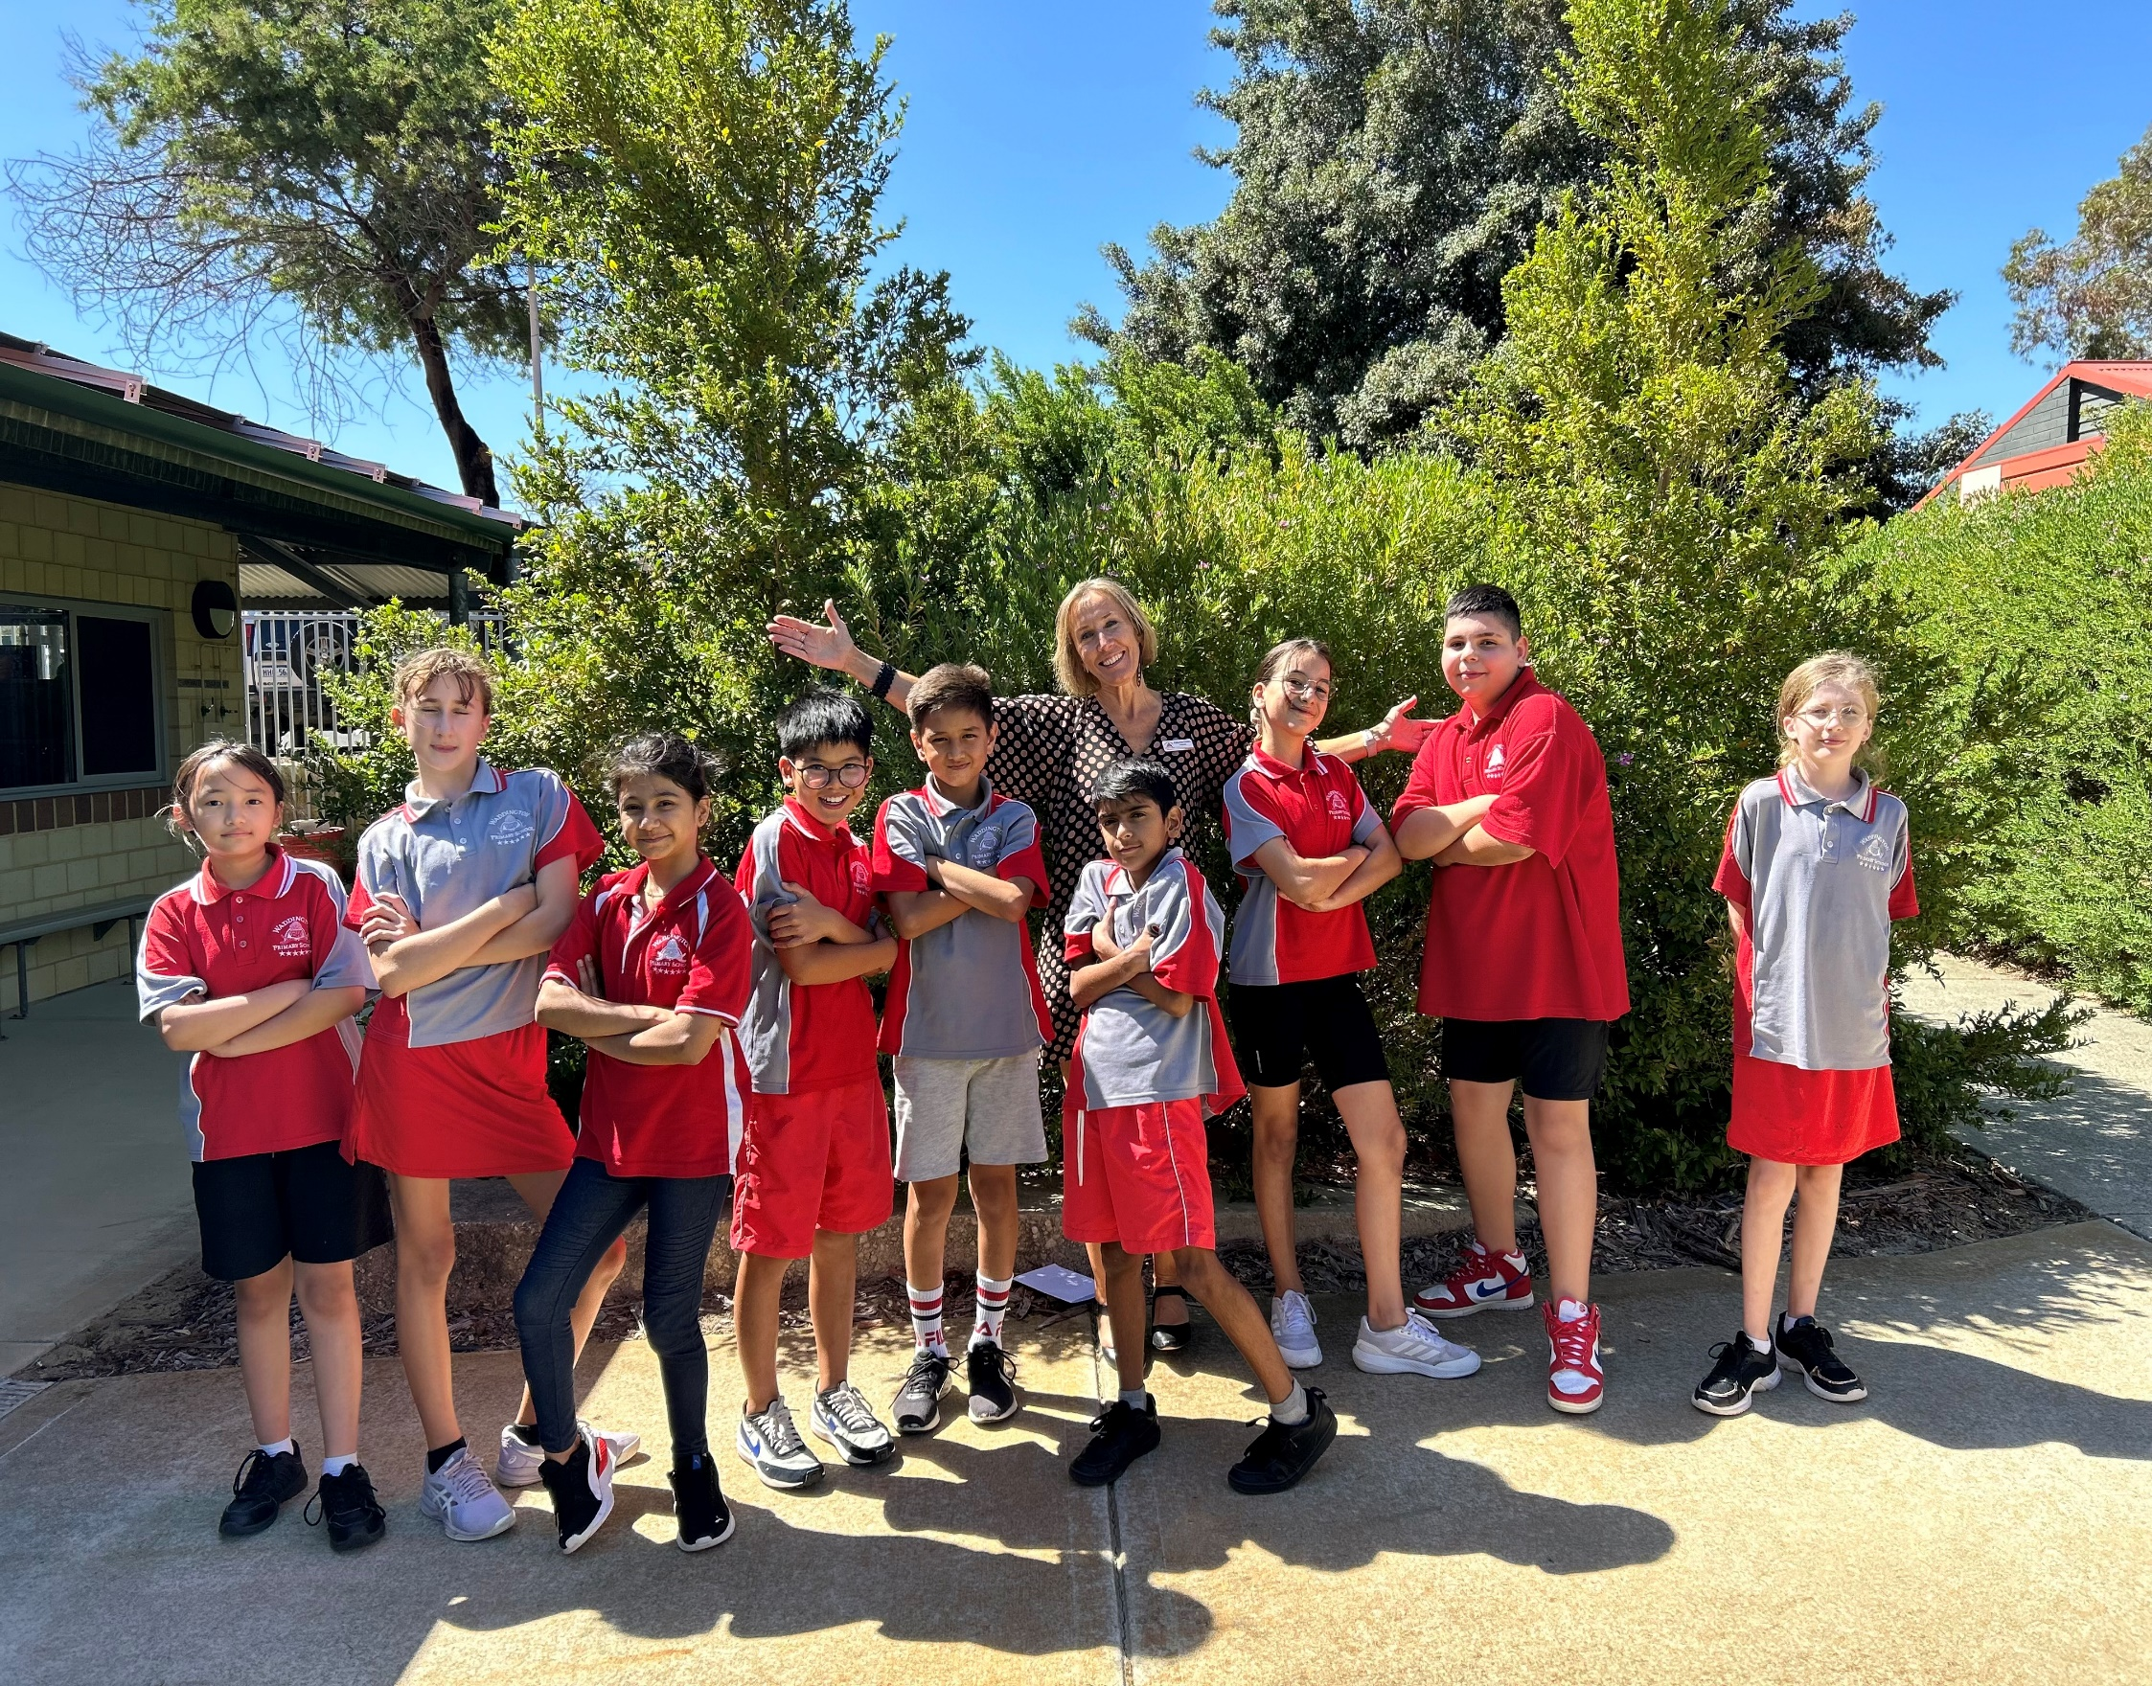

Waddington Primary School
2026 Parent Information
Respect • Responsibility • Kindness • Persistence • Courage

Slide 2
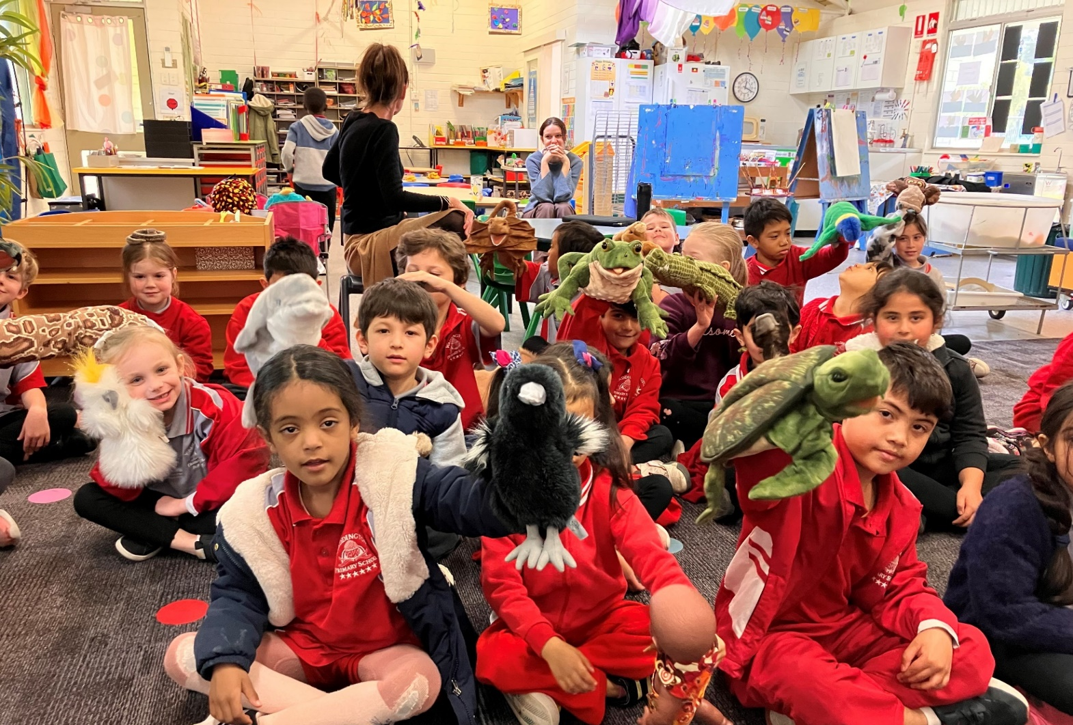
Welcome to Waddington!
Waddington Primary School is an innovative school that provides individual attention to children from Kindergarten to Year Six. We have a strong focus on pastoral care and value the positive relationships we have with our school community. We cater to families seeking individualised care, with a strong community feel.
At Waddington we have high expectation of all our students and encourage everyone to strive to succeed.
Waddington Primary School’s core values are Respect, Responsibility, Kindness, Persistence and Courage. These values are embedded across the school in all that we do and are at the centre of the conversations we have with the children in our care. Our school motto is ‘Strive to Succeed’.
If this is your first child attending school, you are likely to have many questions - please don’t hesitate to ask.
Respect • Responsibility • Kindess • Persistence • Courage
Respect • Responsibility • Kindness • Persistence • Courage

Slide 3
2026 Term Dates
School Hours
Time | Event
8:30am | Classrooms open
8:45am | Learning begins
10:40am – 11am | Morning Recess
12:40pm – 1:20pm | Lunch
3pm (2:30pm Wednesdays) | End of day
 | Start | Finish
Term 1 (9 weeks) | Monday 2nd February | Thursday 2nd April
Term 2 (11 weeks) | Monday 20th April | Friday 3rd July
Term 3 (10 weeks) | Monday 20th July | Friday 25th September
Term 4 (10 weeks) | Monday 12th October | Thursday 17th December
Staff Development Days
There are three staff development days in 2026, where students do not attend school. This provides school staff an opportunity to engage together in professional learning for those days. The staff development days in 2026 are:
Tuesday 2nd June
Friday 4th September
Monday 9th November
Respect • Responsibility • Kindness • Persistence • Courage

Slide 4
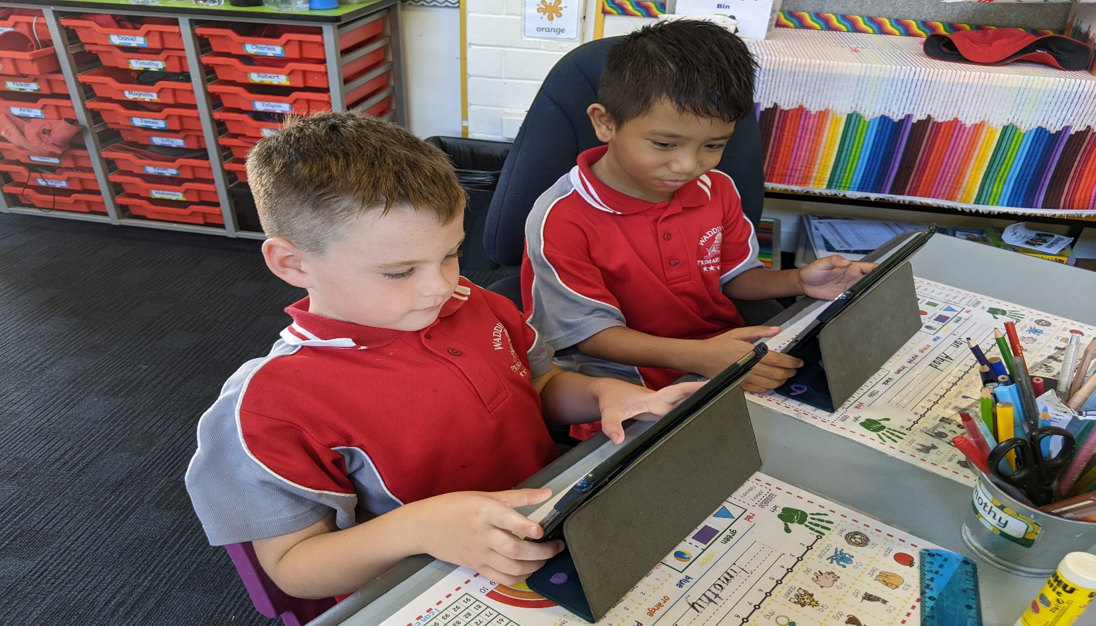
Enrolment Information
When you enrol your child at Waddington, we are required to take a copy of their birth certificate and up-to-date immunisation records (not more than 2 months old).
The information you provide on the enrolment form is very important in helping us look after your child and needs to be kept up to date.
In particular, we need to know of any changes to your:
Address
Email
Phone numbers
Emergency contacts
Custody information
Child’s medical information
Voluntary Contributions
Voluntary contributions provide our school with additional funds, which allow us to enhance the educational programs and resources to the children.
The contribution amount is kept to a minimum as we understand that there are financial pressures on many families.
You can make your contribution of $35 per child at Reception.
Respect • Responsibility • Kindness • Persistence •Courage

Slide 5
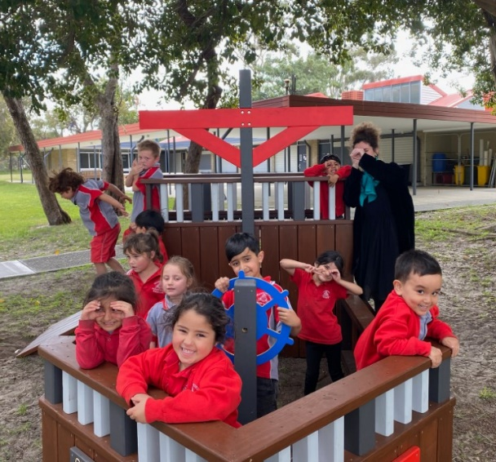
Arriving Late / Leaving Early
The School Day
During the school day we implement a range of activities to develop children to their full potential. These include:
Literacy activities
Mathematics activities
Physical Education
Speech and oral language programs
Engineering and STEM activities
Indoor and outdoor play
Art and craft activities
Protective behaviours
Students are expected to arrive at school and be in their classrooms by 8:45am, in time for the siren. Students who arrive after this time, need to go to the school’s reception to get a late note before going to class.
If you need to take your child out of school during the day, you will need to go to the school’s reception to sign your child out. The staff will arrange for your child to be brought to reception. Any person collecting your child from the school will need to be listed on the enrolment form and/or recorded on our student information system as having authority to collect.
Absentees / Illness
If your child is unwell and unable to attend school, please submit an attendance note on Compass or contact the school by phone, so that we can inform the teacher. If we have not heard from you by 10am, you will receive a text message requesting the reason for their absence.
Please make sure if your child has had a temperature, cough, diarrhoea or has been vomiting, to keep them home for 24 hours past the last episode.
If you child becomes unwell at school, we will contact the emergency contact, in the order that was provided on the enrolment form.
Respect • Responsibility • Kindness • Persistence • Courage

Slide 6

Respect • Responsibility • Kindness • Persistence • Courage

Slide 7

Equipment Required
Please ensure your child brings the
following items to school each day:
School Bag
Drink Bottle
Lunch box with packed lunch, including Recess
Spare set of clothing, including shirt, pants, underwear and socks (Pre-Primary students)
Prior to the beginning of each year, student book lists are sent home to provide parents with a list of required school supplies for the following year. Copies of these lists are available at Reception.
School Uniforms
Our aim is to have all children in uniforms each day. To that end, we sell our uniforms at cost price. We have a strict ‘No Hat, No Sun’ policy at Waddington. This means that children must remain in a designated undercover area during play times if they are not wearing a bucket hat.
Children will be allocated a faction before their first day (Kawlool - Green or Marloo - Blue).
Uniforms can be purchased from our Uniform Shop situated in Block 3 on Fridays from 2.45pm to 3.15pm or complete an order form that can be found at the front office or downloaded from the school's website. We do not have EFTPOS facilities available so payment needs to be in cash (correct amount as change cannot be given) or direct bank transfer (BSB 016 353 Account 3408 73676) including your child’s name and uniforms in the narration. For example, C.Smith – Uniforms.
Respect • Responsibility • Kindness • Persistence • Courage

Slide 8


Waddington Primary School
2026 School Information
WADDINGTON PRIMARY SCHOOL CONTACT DETAILS
Address: 15 Henniker Way, Koondoola WA 6064
Office hours: 8:30am to 3:30pm
Email: Waddington.ps@education.wa.edu.au
Office Phone: (08) 9462 9500
School website: www.waddingtonps.wa.edu.au
Follow us on social media
Facebook: Waddington Primary School
Instagram: waddington_primary_school
Respect • Responsibility • Kindness • Persistence • Courage

Slide 9
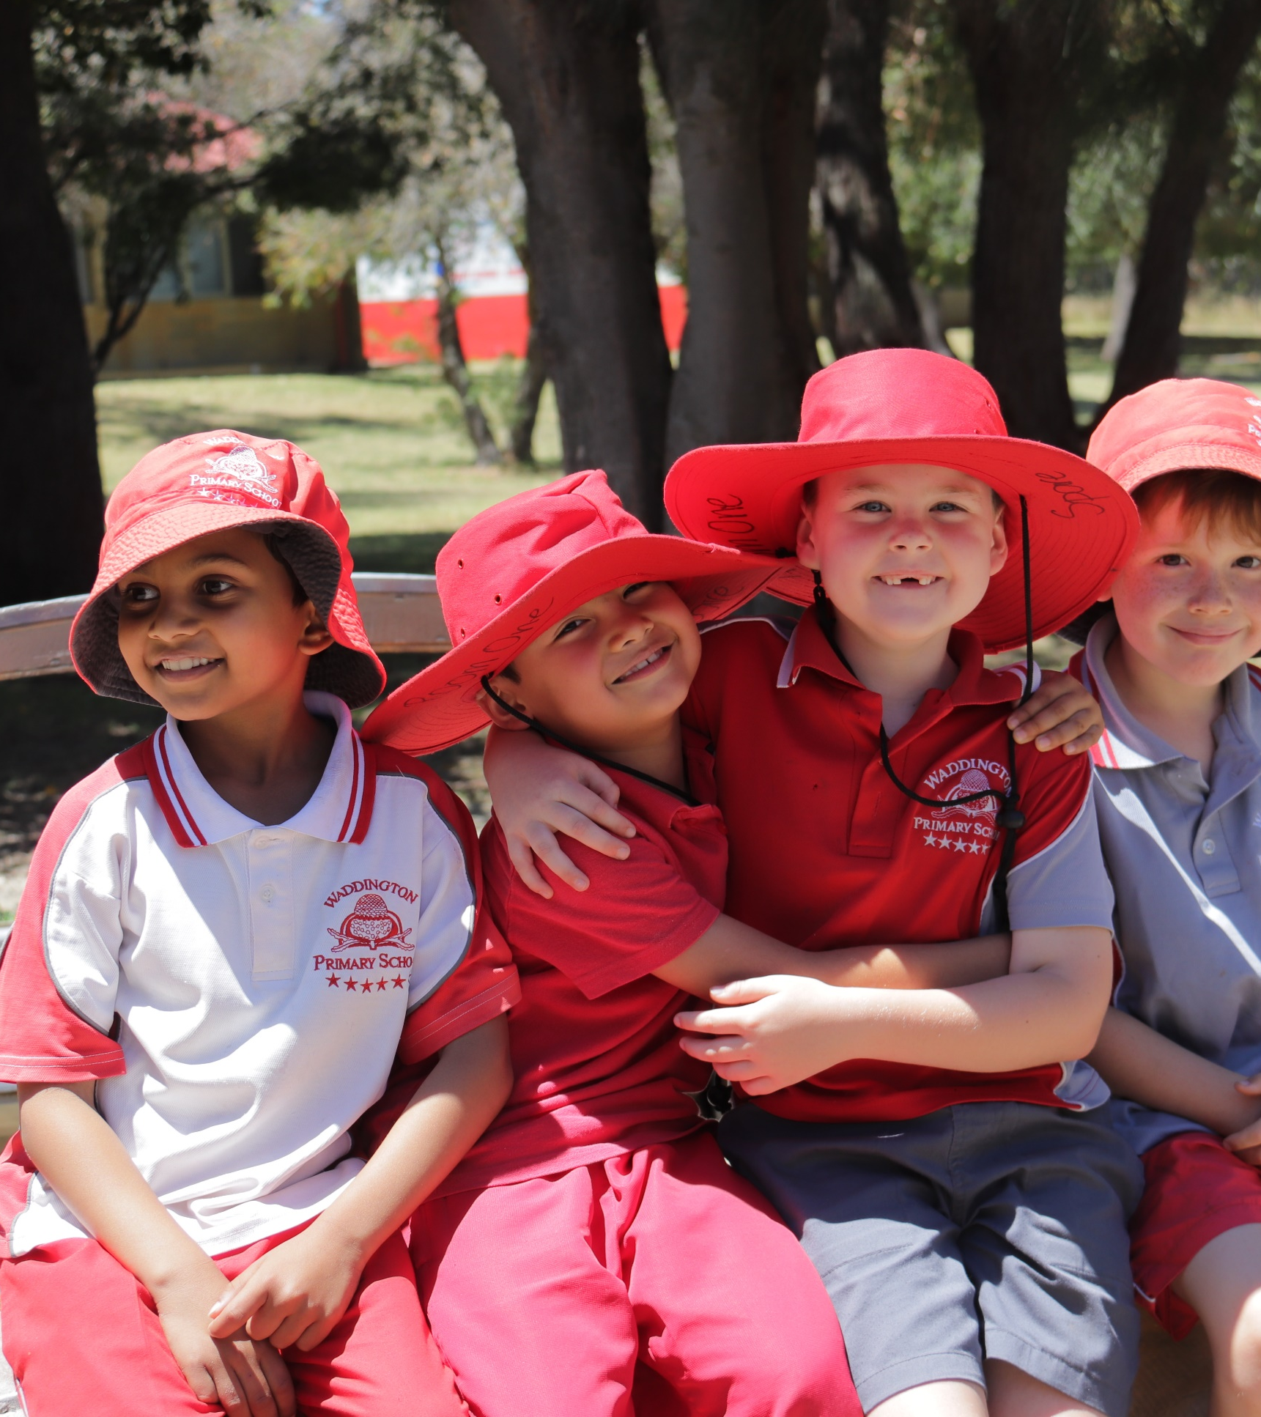
Waddington Primary School
2026 Parent Information
Respect • Responsibility • Kindness • Persistence • Courage

